Slide 1
E-School Website
BY
Padmanabhuni Rajesh
51897572

Slide 2
Introduction
The Pandemic has effecting each of us in a very bad way. Education sector is one of such.
Many children lost about one year of there regular schooling.
But many schools adopted online teaching sessions to keep them engaged with their studies.
The online sessions are being spread out through social media applications like whatapp.
But there are possible security issues and many times there will be confusion in identifying the correct meeting links.
An e-school application that I here proposed would stand as a solution to address this.

Slide 3
Technology Used
The application will be developed using Spring framework integrated with hibernate.
The application was made to run on Tomcat 9.0 Server with 8080 as port number.
The view pages are made as jsp pages
The styling of jsp pages was done using bootstrap and css.
MySQL database was used to persist the data
For testing junit is used by making use of Mockito.
Logger was provided by using log 4j.

Slide 4
Project Description
It consists of three logins. Admin Login, Teacher Login and Student Login.
Admins would be the management tea and they take care of adding new teachers and updating fee details of students.
Teachers can add timetable schedules, upload enotes and new student details.They can give feedback to students
Teacher also have privileges to view the standard wise details getting into updation option.
Student can view timetable and can download enotes from the provided resources
They can also get fee details and status from this application. They can provide feedback.

Slide 5
Table Structure-Admin Credentials
Table Name: Admin
adminId Integer(Primary key & Auto generated)
adminName varchar
Password varchar

Slide 6
Table Structure-Teacher Credentials
Table Name: Teacher
teacherId Integer(Primary key & Auto generated)
teacherName varchar
Password varchar

Slide 7
Table Structure-Student Table
Table Name: Student
Student Id Integer(Primary key & Auto generated)
password varchar
name varchar
standard varchar
fatherName varchar
motherName varchar
dob varchar
email varchar
Phone Long

Slide 8
Table Structure-TimeTable
Table Name: TimeTable
TimeTableId Integer(Primary key & Auto generated)
standard varchar
timeSlot varchar
teacher varchar
subject varchar
meetingLink varchar
meetingDate varchar

Slide 9
Table Structure-Enotes
Table Name: Enotes
Enotes id varchar(Primary key & Auto generated)
Standard varchar
Subject varchar
Topic varchar
Notes(drive link) varchar
Assignment varchar
Due Date varchar

Slide 10
Table Structure-Fee
Table Name: Fee
Fee id Integer(Primary key & Auto generated)
studentId varchar
studentName varchar
standard varchar
feeType varchar
amount Integer
dueDate varchar
Status varchar

Slide 11
Table Structure-Teacher Feedback
Table Name: TeacherFeedback
Feedbackid Integer(Primary key & Auto generated)
Name varchar
likes varchar
dislikes varchar
feedback varchar
rating varchar

Slide 12
Table Structure-Student Feedback
Table Name: StudentFeedback
Feedbackid Integer(Primary key & Auto generated)
studentId varchar
rating varchar

Slide 13
Home Page
Home page will contain three buttons they are Admin Login, Teacher Login and Student Login
These buttons redirect to the corresponding Login pages.

Slide 14
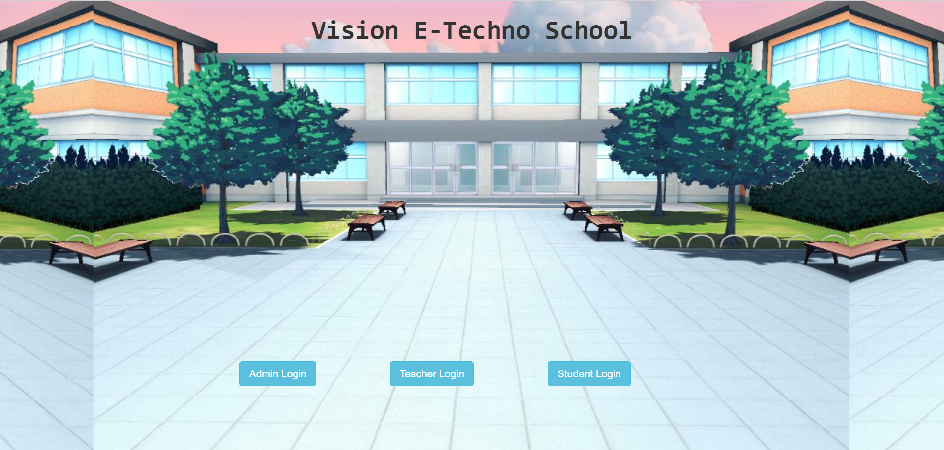

Slide 15

Admin Module
Admin will login into his account by providing necessary credentials.
Admins can register a teacher providing his/her details
They can update fee and check the fee details
He can update fee payment status
Finally,They can logout
Add new Teacher
Update fee details
Check fee details

Slide 16


Slide 17
Put admin home page screen shot here

Slide 18

Teacher Module
Teacher will login into his account by providing necessary credentials.
Teachers can register a student providing his/her details
They can update timetable and enotes
Moreover they can provide feedback on student performance
They can view feedback from students
Add Student feedback
View his/her feedback
Add new student
Update TimeTable details
Update Enotes details

Slide 19
Put teacher login screen shot here

Slide 20
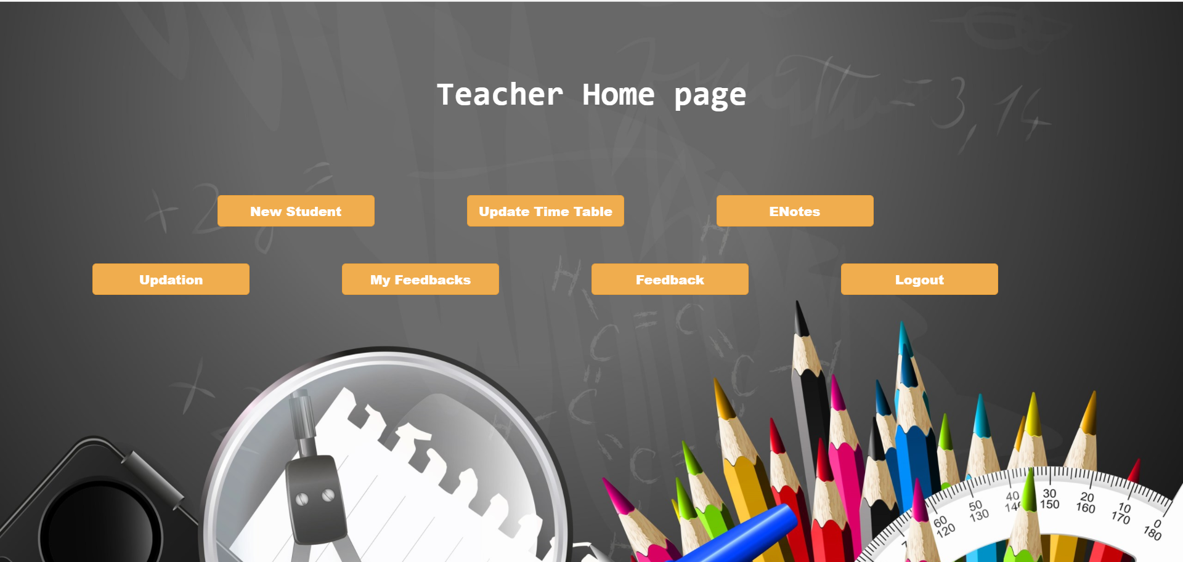
Put admin home page screen shot here

Slide 21
Teacher Module(Standard wise Data)
Moreover teacher can also view the details entered by other teachers by pressing updation button
They can select the standard and can see standard wise details
They can see standard wise timetable, enotes and fee details for reference
View Timetable
View Enotes
View Fee details

Slide 22
Put display page screen shot here

Slide 23

Student Module
Student can login by providing credentials provided by his teacher
Student can view his personal details, timetable and enotes
He can provide feedback to the teacher and can view his performance feedback
Student can also view his fee details and payment status
Provide feedback to teacher
View feedback of his performance
View Timetable
View Enotes
View personal details
View Fee details

Slide 24
Put student login screen shot here

Slide 25
Put studenthome screen shot here

Slide 26
Project Structure
com.main.model(POJO)
->Student.java
->Student.java
->Teacher.java
->TimeTable.java
->Fee.java
->Enotes.java
->TeacherFeedback.java
->StudentFeedBack.java
com.main,controller
->StudentController.java
->TeacherController.java
->AdminController.java

Slide 27
Project Structure
com.main.service
->StudentService.java
->StudentServiceImpl.java
->TeacherService.java
->TeacherServiceImpl.java
com.main.dao
->StudentDao.java
->StudentDaoImpl.java
->TeacherDao.java
->TeacherDaoImpl.java
com.src
->StudentDaoImplTest.java

Slide 28
Project Structure
View Pages
->Home.jsp
->AdminLogin.jsp
->TeacherLogin.jsp
->StudentLogin.jsp
->AdminHome.jsp
->TeacherHome.jsp
->StudentHome.jsp
->TeacherRegistration.jsp
->StudentRegistration.jsp

Slide 29
Project Structure
View Pages
->UpdateEnotes.jsp
->UpdateTimeTable.jsp
->UpdateFee.jsp
->StudentFeedback.jsp
->TeacherFeedback.jsp
->StudentDetails.jsp
->DisplayTimeTable.jsp
->DisplayTimeTableTeacher.jsp

Slide 30
Project Structure
View Pages
->DisplayEnotes.jsp
->DisplayEnotesTeacher.jsp
->FeeDetails.jsp
->StudentDetails.jsp
->viewDetails.jsp
->DisplayStudentFeedback.jsp
->DisplayTeacherFeedback.jsp
->selectID.jsp

Slide 31
Conclusion
This would be handy tools to organize data and better accessibility of e-learning stuff for both teachers and student. This application will avoid entering into wrong meeting links and eradicates ambiguity.
The administrator will find a solution to acknowledge the students about fee details.

Slide 32


